Slide 1

MALLA REDDY TECHNICAL CAMPUS
A constituent Unit of MALLA REDDY VISHWAVIDYAPEETH
(Deemed to be University)
Approved by UGC & AICTE New Delhi
Maisammaguda, Medchal (Dist), Hyderabad – 500100, Telangana
  TEAM MEMBERS :
  Devarakadra varaprasad goud
  Naruje Srinivas
  Varanganti Lokesh
  Palla bhanuprakash reddy

Slide 2

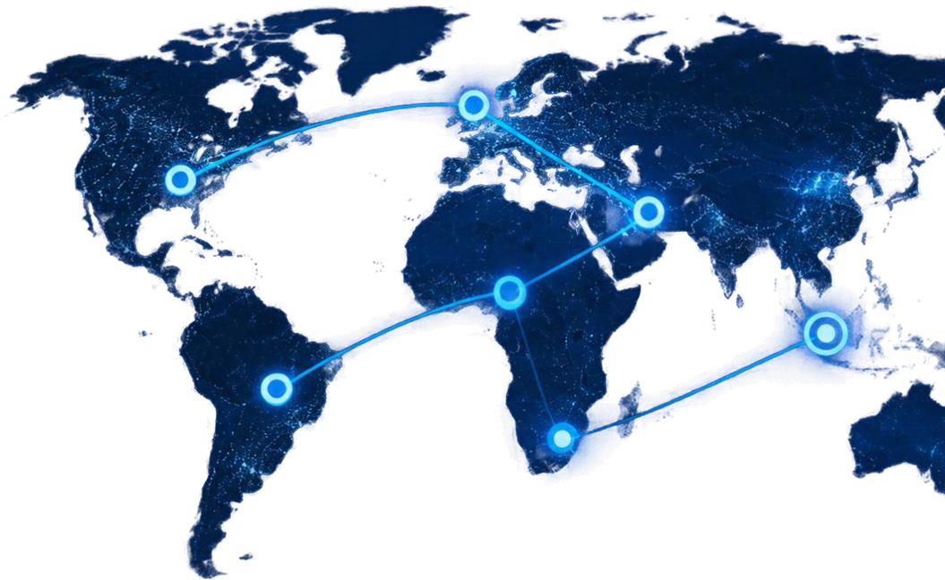
TRAVEL
ITINERARY
OPTIMIZER
Multi-city route optimization
under time and duration constraints
An explainable, algorithm-centric
DAA prototype

Slide 3


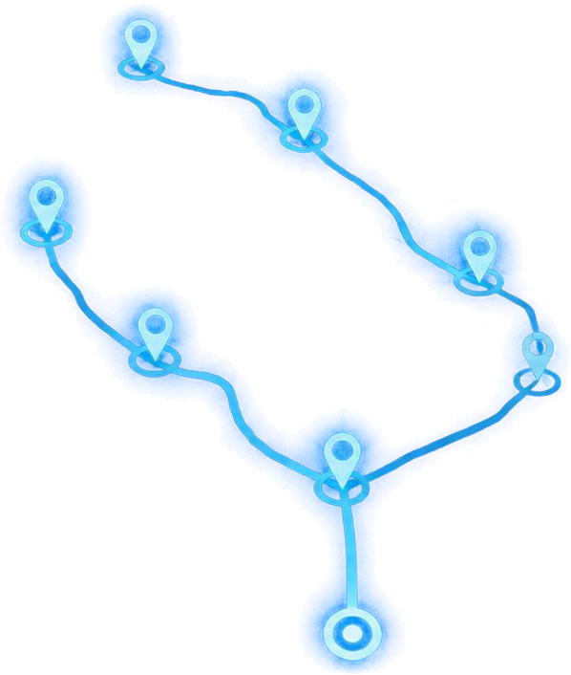
THE CHALLENGE
Plan the best journey that satisfies real-world constraints.
Minimize total travel expenditure
Respect opening and closing time windows
Stay within maximum trip duration
Visit selected locations exactly once
and return to origin

Slide 4
















OUR INNOVATION
All Possible Routes
TSP with Time Windows + Maximum Duration
Plan routes that respect opening/closing times and total trip limits
Bounding & Pruning
Branch & Bound with Pruning
Explore fewer possibilities using cost and schedule bounds
Promising States
Bellman-Held-Karp Dynamic Programming
Exact optimization on smaller subproblems
Optimal Solution
Greedy Baseline & Benchmark
Compare against a fast heuristic baseline
Explainable by Design
Every decision, bound, state, and prune is visible

Slide 5






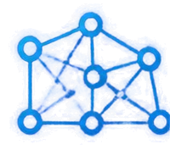
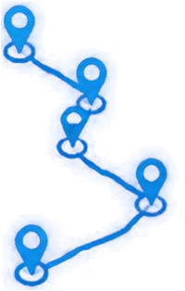

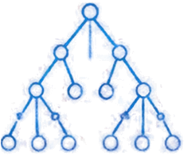
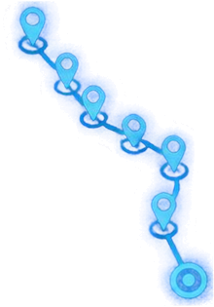






HOW IT WORKS
From data to the optimal feasible itinerary
01
02
03
04
05
Provide destinations, coordinates, fees, hours and travel data
Build graph and cost/time matrices
Generate a greedy upper bound
Run Branch & Bound and Dynamic Programming
Reconstruct and visualize the optimal feasible itinerary

Slide 6










TECHNOLOGY & ALGORITHM
SYSTEM ARCHITECTURE
ALGORITHMS & COMPLEXITY
Frontend
Backend
Solver Engine
Branch & Bound
Exponential worst case with pruning
React 19
Vite 8
SVG animations
Python 3.9
Flask 3.0
Optimization Algorithms
Held-Karp DP
Interactive itinerary visualization
REST API
Request handling
Compute optimal and near-optimal routes
O(N²2ⁿ)
Greedy Nearest Neighbor
Data Store
O(N²)
Locations & Constraints

Slide 7



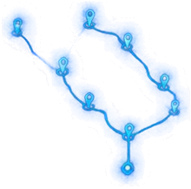




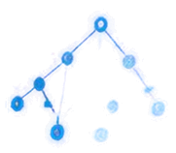
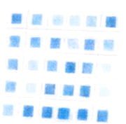




DEMO & IMPACT
Live capabilities that turn complex routing into clear, measurable outcomes.
Route Optimizer
Route Map
Itinerary Timeline
INTERACTIVE ROUTE MAP
Visualize the optimized journey on a dynamic map.
CHRONOLOGICAL ITINERARY
See the wait, visit, and return timeline in order.
BRANCH & BOUND EXPLORER
Branch & Bound Explorer
DP Subproblem Table
Benchmark Dashboard
Step through the search tree and pruning decisions.
Total Cost
Total Duration
Runtime
States Explored
Pruning Ratio
DP SUBPROBLEM VIEW
Inspect memoized subproblems and transitions.
BENCHMARK DASHBOARD
Track cost, duration, runtime, states, and pruning ratio.

Slide 8

FUTURE VISION
Explainable optimization prototype achieved
Expand destination and routing data sources
Scale search with stronger bounds and parallelism
Deployment and real-world travel integration
THANK YOU
Q&A

